Slide 1
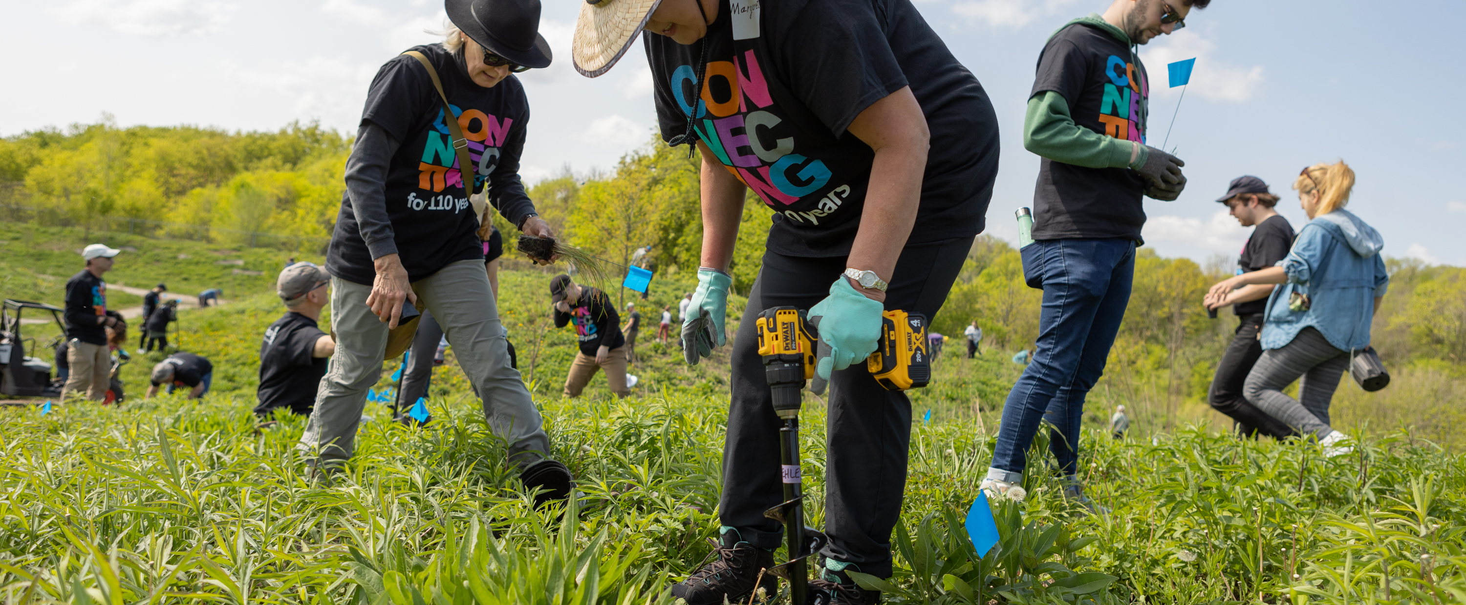

PETS Alliance – public Image Breakout
July 23-25 2025

Slide 2
subhead
Public Image Beyond the Logo
Effective Marketing & Messaging
Nancy Davidson, Marketing Manager
Petina Dixon-Jenkins, Corporate Communications Manager
Jean Saunders, Marketing Lead, Brand Experience

Slide 3
subhead
Our Action Plan asks us to increase awareness of our impact and brand – by strengthening our public image.
What is public image?
What is Rotary’s public image?

Slide 4


THERE IS NO COMMON IMAGE OR UNDERSTANDING
Q: What word or phrase first comes to mind when you think of Rotary?
Rotary Awareness & Understanding Study, 2022.
United States Public Image Report. 2022, 2023

Slide 5
subhead
We’re all Rotary brand ambassadors.
What does it mean to be a brand ambassador?
How can PELS inspire presidents-elect to tell stories of the impact (and their members)

Slide 6


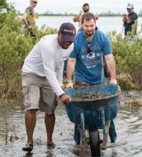
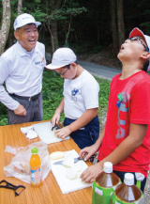

Enhancing public understanding of Rotary
Experiences with our clubs and programs
The stories we tell
The images we share
Notes:
Create powerful messages
People’s perception of Rotary comes from their experiences with our clubs and programs, as well as from the stories we tell and the images we share. In addition to offering people a great experience, keeping our communications consistent and compelling strengthens our brand and reinforces that we’re people of action.

Slide 7
subhead
Rotary provides resources to support members to tell their stories – on the Learning Center, on the Brand Center.
How will you incorporate Rotary’s public image learning resources into your PELs (PETs)?

Slide 8
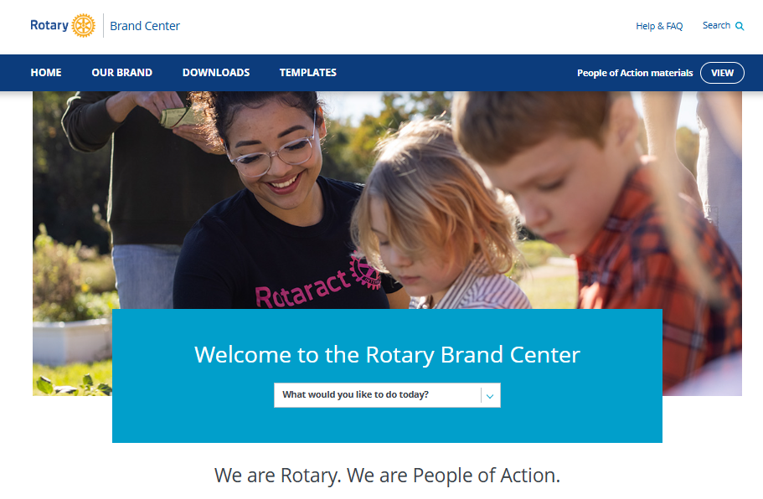

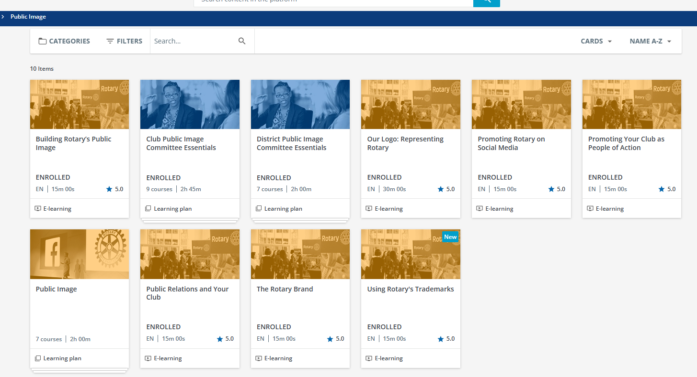
subhead

Slide 9
subhead
Using Rotary branding correctly and consistently strengthens our brand.
How can we encourage clubs to use the Rotary branding correctly and consistently? How can PELs support club branding efforts?

Slide 10







Lead by example
Ensure the vendors at your events follow brand guidelines
Ensure the branding for your PELs follows guidelines
Notes:
Create powerful messages
People’s perception of Rotary comes from their experiences with our clubs and programs, as well as from the stories we tell and the images we share. In addition to offering people a great experience, keeping our communications consistent and compelling strengthens our brand and reinforces that we’re people of action.

Slide 11
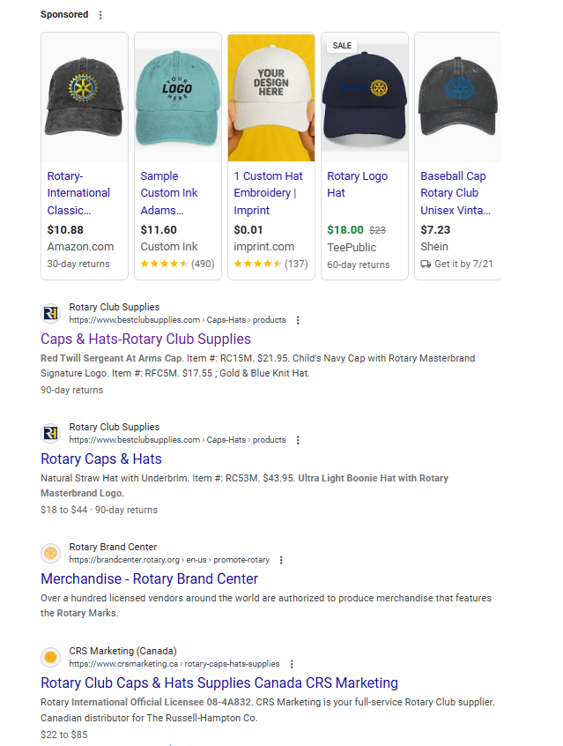
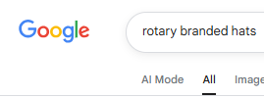

subhead

Slide 12
subhead
Many clubs use the President’s Message in their communications.
How should clubs use the President’s Message during the Rotary year?
How do you use it?
What would make you more likely to use it?

Slide 13
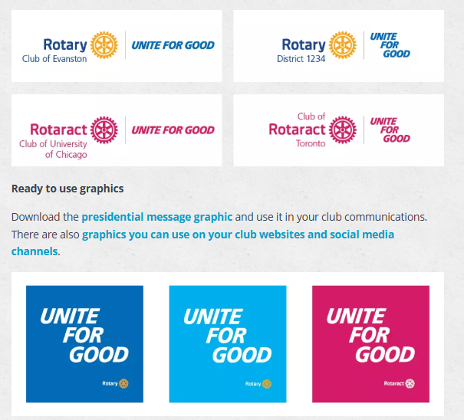
Brand Center Guidance and Resources
Notes:
Create powerful messages
People’s perception of Rotary comes from their experiences with our clubs and programs, as well as from the stories we tell and the images we share. In addition to offering people a great experience, keeping our communications consistent and compelling strengthens our brand and reinforces that we’re people of action.

Slide 14




Public Image Resources for PETS
The official blog of Rotary International
Brand Center
Learning Center
Rotary Voices
Research Reports
rotary.org/brandcenter
learn.rotary.org
blog.rotary.org
My Rotary
search: Rotary Research
brand guidance
videos/images – >1000
public image presentations - 11
public image courses - 6
public image learning plans
public image posts
awareness & understanding - US
member survey

Slide 15
QUESTIONS

